Slide 1

STEM @SPCC
AI Project Group
Morning Assembly
12 Nov 2021
Logo Design: Isaac LEE

Slide 2
INTRODUCTION
Research
What is the AI Project Group about?
Competitions
Team
Structure
Notes:
Research
Competitions
Learning resources

Slide 3
RESEARCH
Research
Data Collection / Processing
AI Model training
Evaluation
Full project cycle

Slide 4
Extension and Translation of Fonts Across Languages
PROJECT HIGHLIGHTS

Slide 5
Extracting the content and font of words from any language
FONT

Slide 6
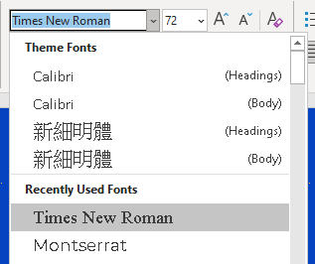
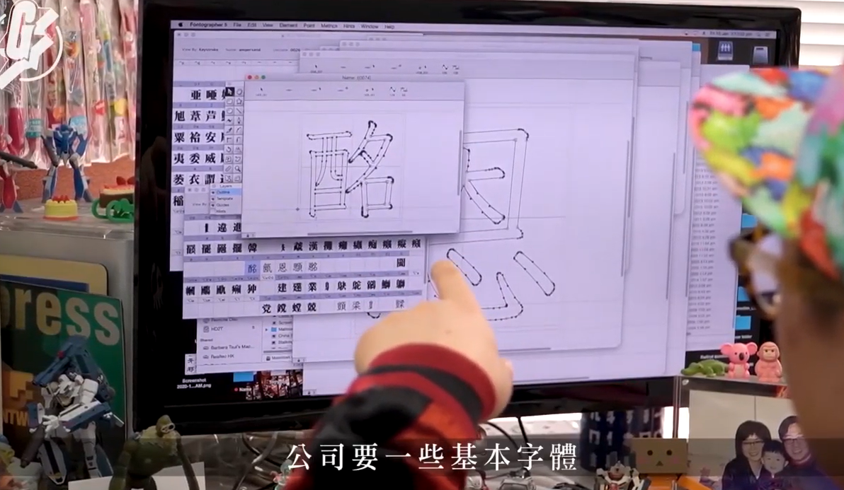

FONT
Have you ever wondered…
1
2
Times New Roman in Chinese?
Design font families with just a single character?

Slide 7

RESULTS
Content φ,
Font α
Content γ,
Font β
Keep
font
Keep content
Encode (Combine)
Content γ,
Font α

Slide 8





RESULTS
Training Iterations
Japanese
Greek
Greek
Special characters
Serif fonts

Slide 9
FONT

Slide 10



Unique significance
FONT
Font Design
Generating font families with just a single character
Business
Designing company fonts and enhancing business image
Criminology
Solving cases based on suspect’s handwriting

Slide 11
Non-line of sight (NLOS) object classification
PROJECT HIGHLIGHTS

Slide 12
Classify objects based on the captured reflections
NLOS

Slide 13
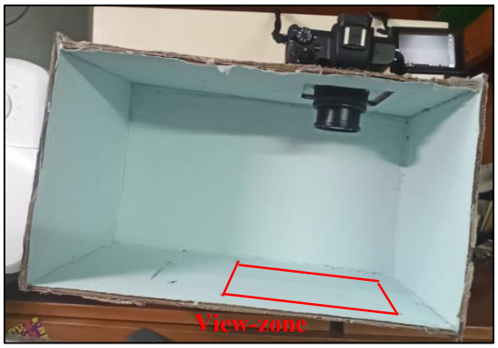
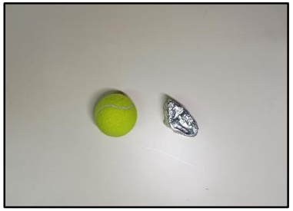
NLOS
NLOS zone

Slide 14
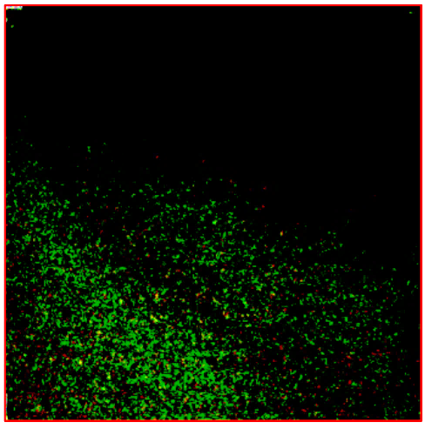


NLOS
Tennis Ball
Aluminium
foil wrap
Green acrylic
board

Slide 15
INTRODUCTION
Research
What is the AI Project Group about?
Competitions
Team
Structure
Notes:
Research
Competitions
Learning resources

Slide 16
COMPETITIONS
High achievements
Since 2019
Novel Eye-to-face Synthesis with Standard Deviation Loss
Real-time Singing Voice Vocal Register Classification
1st Prize -- SenseTime IAIF
Merit – NewGen HKYSTIC 2020
Merit – NewGen HKYSTIC 2021
2nd Prize -- Second Sensetime International Artificial Intelligence Fair
Cantonese Lip Reading
Universal Font Style Transfer Across Languages
Special Prize -- First Sensetime International Artificial Intelligence Fair;
Champion -- Sensetime x CUHK AI Competition for Secondary Schools;
Intel ISEF Regional Finalist
Merit – NewGen HKYSTIC 2020
1st prize - SenseTime IAIF

Slide 17
A New Approach to Eye-To-Face Synthesis
PROJECT HIGHLIGHTS

Slide 18
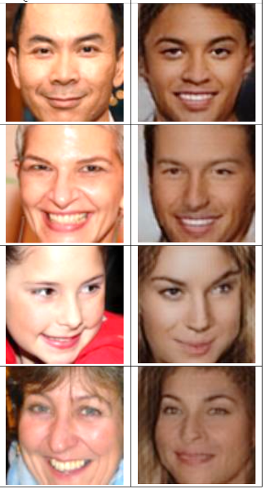







EYE
Input
AI
Target
Input
(Left/Right eye)

Slide 19
The Simpler the Better:
A Novel Adversarial Approach towards Weakly Supervised Image Segmentation
PROJECT HIGHLIGHTS

Slide 20
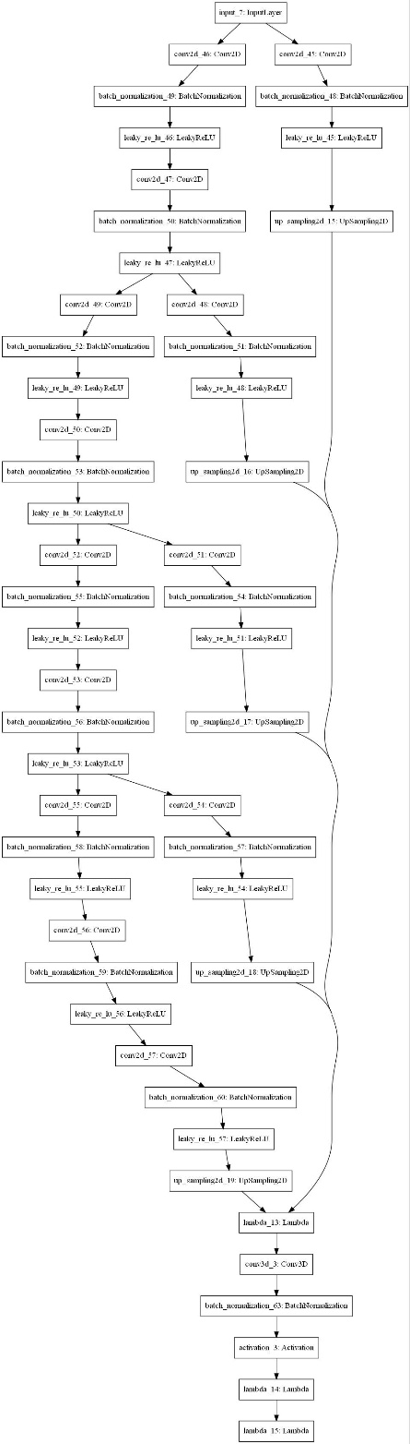


IMAGE SEGMENTATION
Overview
1
2
< Diagram of our model
We can spot the horse with common sense. However, computers have no ‘common sense’!
Upon training, computers can segment the target object and the background
i.e. some of us are computers

Slide 21
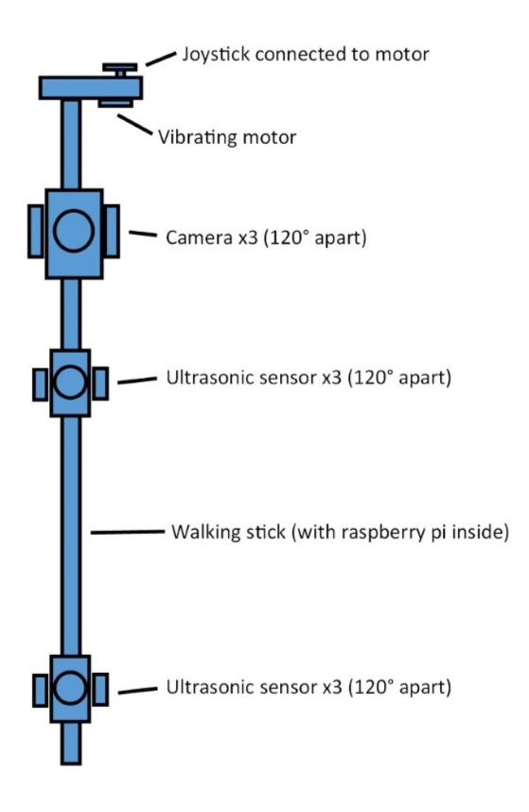
IMAGE SEGMENTATION
Application
Functions
Alarming system
Obstacle detection
Object classification and detection
Real-time safety monitoring system
Continuous improvement
Improving user experience
Feasibility in more circumstances
Durability
Robustness

Slide 22
IMAGE SEGMENTATION
Methodology
1. Modified U-Net structure
2. Adversarial Training
Segmenter learns to mask pixels containing the object
Classifier learns to identify the smallest details

Slide 23








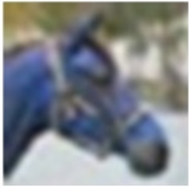





Ground-truth
Predicted
Ground-truth
Predicted

Slide 24
INTRODUCTION
Research
What is the AI Project Group about?
Competitions
Team
Structure
Notes:
Research
Competitions
Learning resources

Slide 25



Unparalleled opportunities
RESOURCES
Core members
Project leads
Members
Exposure to rich learning resources
Academia connections
Competitions & Research opportunities

Slide 26
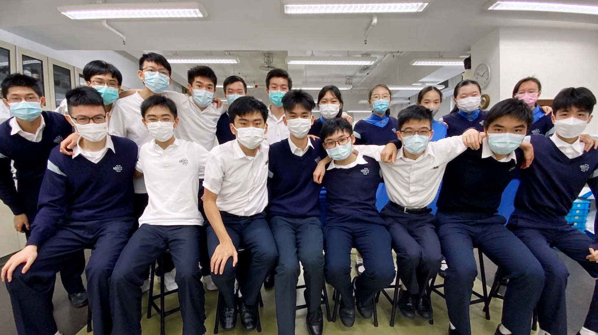
TEAM PHOTO
Notes:
Research
Competitions
Learning resources

Slide 27
MEMBERS
Teacher Advisors
Group Members
Mr Tse Wai Tak
2A
2D
3C
3C
3E
3G
4F
4H
5A
Chloe Fan
Kitty Cho
Dione Cheung
Patrick Lai
Esther Or
Ian Chong
Lucas Ma
Tiffany Suen
Nathan Ng
5E
5G
5I
5I
6A
6H
6H
6I
Angus Wong
Vera Chuang
Anthony Chan
Daniel Shi
Ronnie Jok
Isaac Lee
Peter Ng
Matthew See
Ms Lau Oi Ha
Core Members
5A
5D
5I
6C
6I
Lennon Chan
Justin Cheng
Billy Gao
Rex Tse
Justin Tang
Notes:
Research
Competitions
Learning resources

Slide 28
STEM @SPCC
STEM @SPCC
Local STEM programs
STEM
Team Programs
STEM Competitions
Notes:
Research
Competitions
Learning resources

Slide 29
STEM @SPCC
STEM @SPCC
Programmes by the school STEM Team
AI Project Group
F.2 ACE STEAM Module
Online STEM courses
AI and advanced Python
Explorer2 DIY Robot Rover with Camera
Notes:
Research
Competitions
Learning resources

Slide 30
STEM @SPCC
STEM @SPCC
Programmes by local universities/organizations
STEM 4 Girls Mentorship Programme
FinTech Summer Program 2021
Soccer Robot Workshop
CLP “Engineering in School” Programme
CLP e-playground STEM workshop
CUHK STEAM@Soybean Project
IEEE Hong Kong STEM Student Conference 2021
STEM 4 Girls Mentorship Programme
仰望星空話天宮
Notes:
Research
Competitions
Learning resources

Slide 31
STEM @SPCC
STEM @SPCC
STEM Competitions
Hong Kong Olympiad in Informatics 2020-21
Hong Kong Youth Science and Technology Innovation Competition
STEM & E Consortium - STEM & E competition 2021
第三届国际青少年人工智能交流展示会
CUHK Jockey Club AI for the Future Secondary School Think and Create Competition 2021
Hong Kong Student Science Project Competition
Hong Kong Budding Scientists Award
Hong Kong Olympiad in Informatics 2021
Notes:
Research
Competitions
Learning resources

Slide 32
Thank you!
STEM @SPCC
Morning Assembly
12 Nov 2021
Logo Design: Isaac LEE

